Slide 1
BRINGING WORKERS IN CANADA
LMIA VS FRANCOPHONE MOBILITY

Slide 2
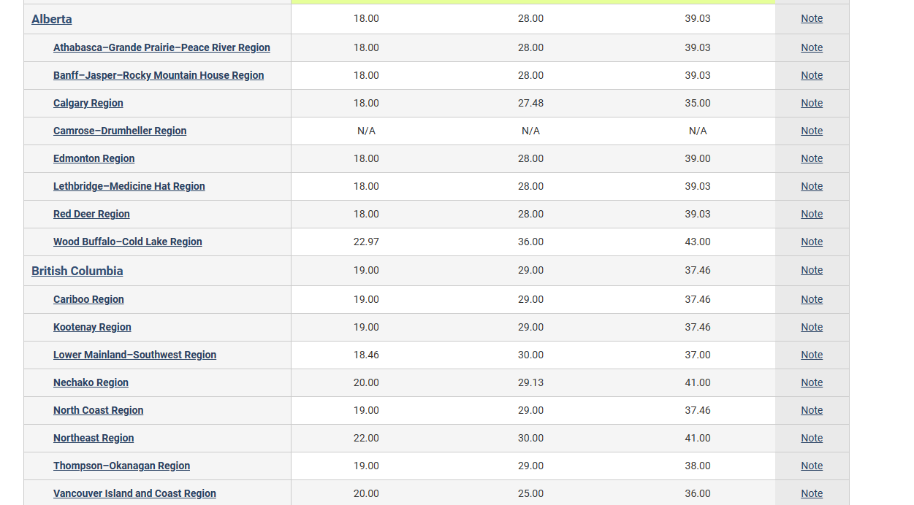
CARPENTER

Slide 3
LMIA VS Francophone mobility
For LMIA there is a minimum of medium wage that need to be considered for the application
For Francophone mobility there is minimum wage that need to be considered
Between minimum and median wage there is a 10$ difference per hour

Slide 4
LMIA VS Francophone mobility
For an average of 160 hours per months this represent a $ 1600 in saving per employee
LMIA cost is $1000/ employee, the employer compliance program is only $230
For 1 people there is a saving of $19,200 per year plus LMIA- employer compliance $770 for a total of $19,970/ employee plus 3,000 recruiting fees and 1,500 immigration fees minus recruiting fees of 20% of 7,680= 16,020 savings per employee, per year

Slide 5
LMIA VS Francophone mobility
For 50 people there is saving of 801,000/ year and 1,602,000/ 2 years
All the calculation is referring to standard hours of 160/ month
For standard plus overtime of 40 hours per month there is an additional savings of 660 / month
For 50 people of 660, there is an additional CAD396,000savings per year

Slide 6
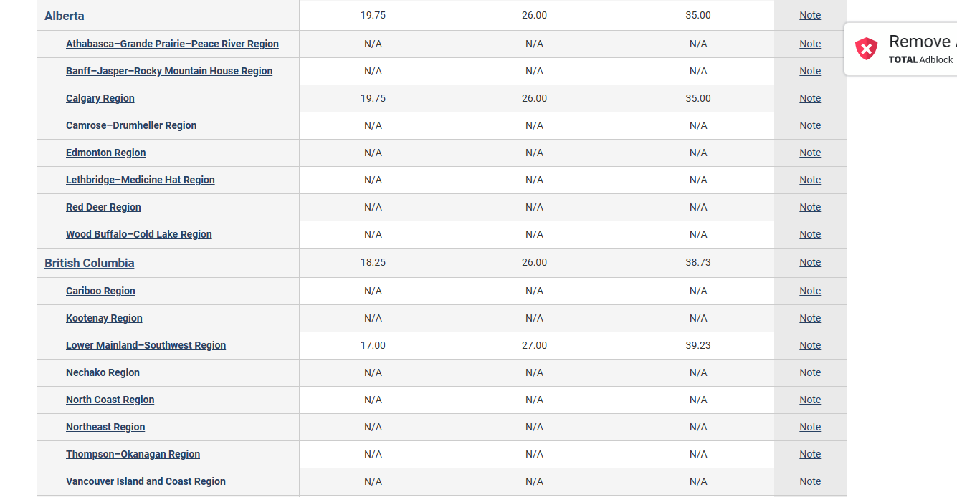
TILE INSTALLER

Slide 7
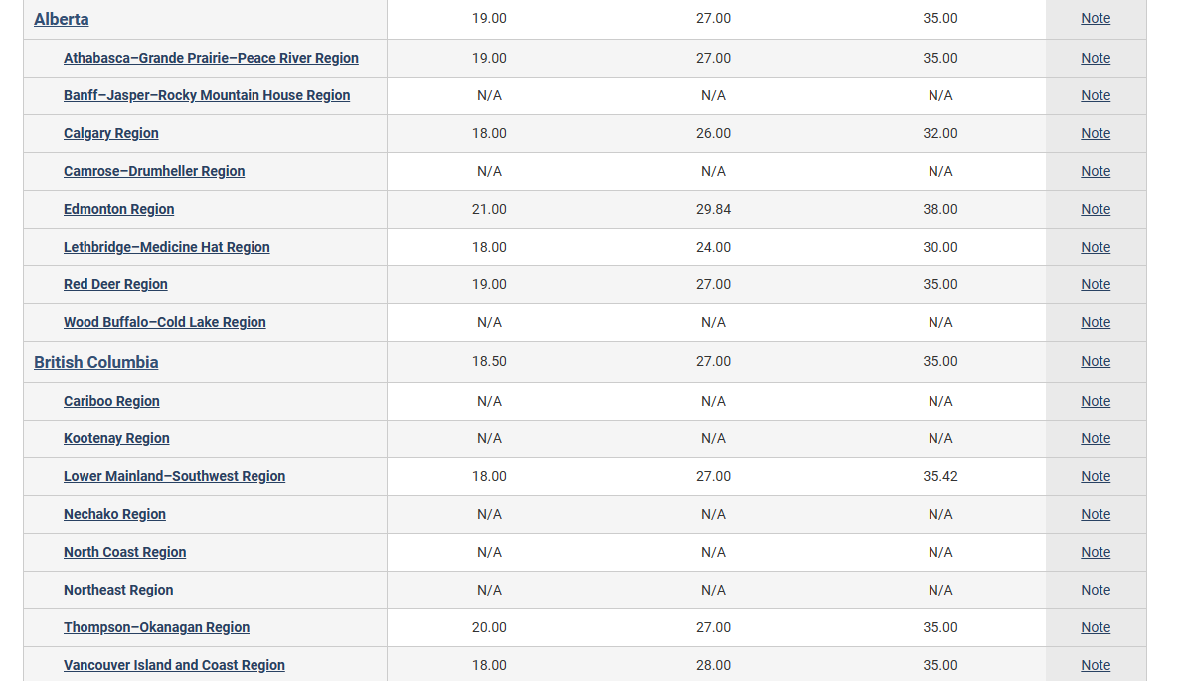
DRYWALL INSTALLER

